Slide 1
MEMORY UNIT

Slide 2
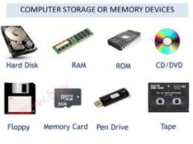
MEMORY UNIT
Computer memory is the storage space in the computer, where data is to be processed and instructions required for processing are stored. The memory is divided into large number of small parts called cells. Each location or cell has a unique address. Memory is primarily of three types −
Cache Memory
Primary Memory/Main Memory
Secondary Memory
Cache Memory:
Cache memory is a very high speed semiconductor memory which can speed up the CPU. It acts as a buffer between the CPU and the main memory. It is used to hold those parts of data and program which are most frequently used by the CPU.
Advantages
Cache memory is faster than main memory.
It consumes less access time as compared to main memory.
It stores the program that can be executed within a short period of time.
It stores data for temporary use.
Disadvantages
Cache memory has limited capacity.
It is very expensive.

Slide 3
Units of Memory:
The smallest unit is bit, which mean either 0 or 1.
1 bit = 0 or 1
1 Byte = 8 bit
1 Nibble = 4 bit
1 Kilo Byte = 1024 Byte= 2¹⁰ Byte
1 Mega Byte = 1024 KB= 2¹⁰ KB
1 Gega Byte = 1024 MB= 2¹⁰ MB
1 Tera Byte = 1024 GB= 2¹⁰ GB
1 Peta Byte =1024 TB= 2¹⁰ TB
1 Exa Byte =1024 PB= 2¹⁰ PB
1 Zetta Byte = 1024 EB= 2¹⁰ EB
1 Yotta Byte = 1024 ZB= 2¹⁰ ZB

Slide 4
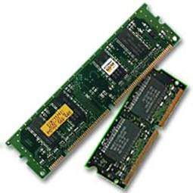
Main Memory
Main Memory is often known as Primary memory. It is not like human memory because data stored in this memory, automatically flushes out with power cut off and can not be recovered later. So it is also known as volatile memory. It is the workplace of a computer system where data is to be kept on temporary basis for the purpose of processing. Every memory location has a definite address. The total time taken to access data from memory is called Memory Access Time .
Characteristics of Main Memory
These are semiconductor memories.
Usually volatile memory.
Data is lost in case power is switched off.
It is the working memory of the computer.
Faster than secondary memories.
A computer cannot run without the primary memory.

Slide 5
Secondary Memory
Secondary Memory is also known as external memory or non-volatile memory. It is slower than the main memory. These are used for storing data/information permanently. CPU directly does not access these memories, instead they are accessed via input-output routines. The contents of secondary memories are first transferred to the main memory, and then the CPU can access it. For example, disk, CD-ROM, DVD, etc.
Characteristics of Secondary Memory
These are magnetic and optical memories.
It is known as the backup memory.
It is a non-volatile memory.
Data is permanently stored even if power is switched off.
It is used for storage of data in a computer.
Computer may run without the secondary memory.
Slower than primary memories.

Slide 6
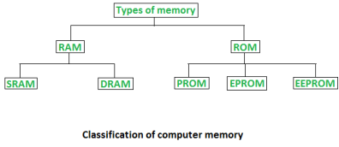
Memory classification
Main Memory or primary memory is divided into two types-
–RAM (Random Access Memory)
–ROM (Read Only Memory)
The memory which is in direct contact of CPU is known as primary memory. RAM and ROM both remains in direct contact of CPU.
Random Access Memory (RAM) –
It is also called as read write memory or the main memory or the primary memory.
The programs and data that the CPU requires during execution of a program are stored in this memory. It is a volatile memory as the data loses when the power is turned off. Relatively cheap per megabyte stored compared to ROM, but relatively expensive compared to secondary memory. It is not possible to imagine processing without RAM.
The efficiency of RAM depends upon the size (capacity)of RAM.RAM supports both read and write operations.
RAM is further classified into two types- SRAM (Static Random Access Memory) and DRAM (Dynamic Random Access Memory).

Slide 7
DRAM AND SRAM
DRAM basically consists of transistor and capacitor which stores electric charge.As per switching of Transistor, capacitor may contain a charge (1 bit ) or may not contain a charge(0 bit). DRAM needs to be refreshed again and again which is a tedious job for processor.
•SRAM is made up of internal Flip-Flops where 1 Flip-Flop is capable of storing 1 bit.It occupies more space as compared to DRAM.It is fast as compared to DRAM.SRAM is expensive as compared to DRAM.
Volatile memory is computer memory that requires power to maintain the stored information. Most modern semiconductor volatile memory is either Static RAM or dynamic RAM.
Static RAM retains its contents as long as the power is connected and is easy to interface to but uses six transistors per bit. Dynamic RAM is more complicated to interface to and control and needs regular refresh cycles to prevent its contents being lost. However, DRAM uses only one transistor and a capacitor per bit. SRAM is used for cache memories , where DRAM is used as main memory.

Slide 8
ROM
ROM (Read Only Memory) stores crucial information essential to operate the system, like the program essential to boot the computer. It is not volatile as always it retains its data.ROM is further classified into 4 types- ROM, PROM, EPROM, and EEPROM. ROM is of following types -
ROM (Read Only Memory)
PROM (Programmable Read Only Memory)
EPROM (Erasable Programmable Read Only Memory)
EEPROM(Electrically Erasable Programmable Read Only Memory)
Types of Read Only Memory (ROM) –
PROM (Programmable read-only memory) –PROM is different from as a ROM is programmed (i.e. has data written to it) during the manufacturing process, a PROM is manufactured in an empty state and then programmed later using a PROM programmer or user. Once programmed, the data and instructions in it cannot be changed.
EPROM (Erasable Programmable read only memory) –as the name suggests, data stored in an EPROM can be erased and reprogrammed. Erasing an EPROM involves removing previous data from the computer and exposing it to ultraviolet light before re-burning/reprogramming it.
EEPROM (Electrically erasable programmable read only memory) – The data can be erased by applying electric field, no need of ultra violet light. We can erase only portions of the chip.

Slide 9
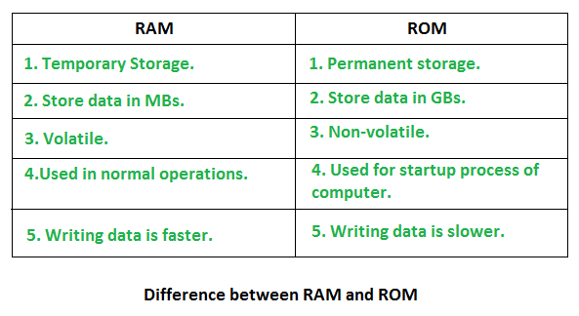
Difference between RAM and ROM
Note: The most important things to understand about RAM are that RAM memory is very fast, it can be written to as well as read, it is volatile (so all data stored in RAM memory is lost when it loses power) and, finally, it is very expensive compared to all types of secondary memory . Read-only memory (ROM) is a type of non-volatile memory used in computers and other electronic devices. Data stored in ROM cannot be electronically modified after the manufacture of the memory device. RAM is costlier than ROM as it involves more complex technology to store information & also it is very much faster than ROM.

Slide 10
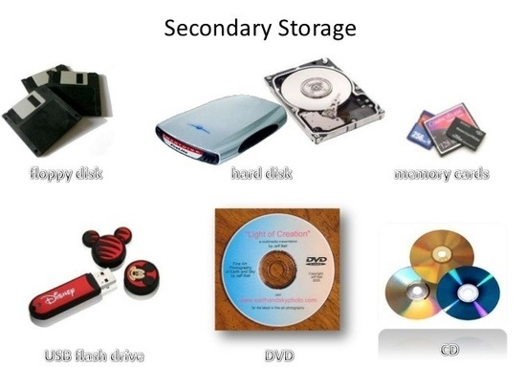
Storage Unit
A secondary storage device refers to any non-volatile storage device that is internal or external to the computer. It can be any storage device beyond the primary storage that enables permanent data storage. A secondary storage device is also known as an auxiliary storage device or external storage It is required to store data in computer for the purpose of processing in future. Because Primary memory has its own limitations, secondary storage or storage unit is very much required. Secondary storage is used to store large amount of data. Various secondary storage devices are available in market now a days.
–Hard disk (Internal/External)
–Pen drive
–CD
–DVD
–Blue Ray Disks
–Memory Cards
–Magnetic Tapes

Slide 11
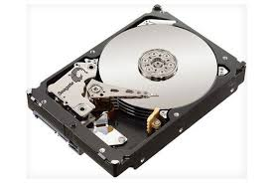
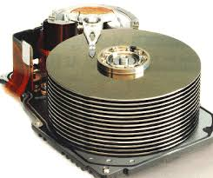
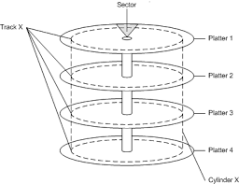
Hard Disk
Hard Disk Drives are commonly used as the main storage device in a computer. HDDs often store operating system, software programs and other files. It is a non-volatile memory hardware device that controls the positioning, reading and writing of the hard disk.
A hard disk is a sealed unit containing a number of platters in a stack. It can be mounted in a horizontal or a vertical position and electromagnetic read/write heads are positioned above and below each platter. As the platters spin, the drive heads move in toward the center surface and out toward the edge. In this way, the drive heads can reach the entire surface of each platter.
Each disk consists of platters, rings on each side of each platter called tracks, and sections within each track called sectors. A sector is the smallest physical storage unit on a disk, almost always 512 bytes in size.

Slide 12
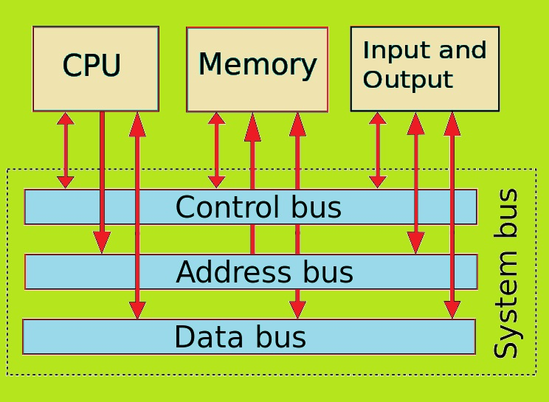
System bus
The group of wires used to connect main parts of Computer system is called System Bus which creates an electronic path for the transfer of data.
•System bus is used to transfer data and instructions between the various components of computer system.
•The part of System bus that carries data is called Data Bus.
•The part of System bus that carries instructions is called control bus.
•The part of System bus that carries memory address is called Address Bus.
•And the bus connected with input/output units is called I/O bus.

